Slide 1


National Housing Finance Corporation/Human Settlements
Development Bank
NEF PROPERTY SECTOR WEBINAR
PROPERTY SECTOR
19 November 2020
LAYING STRONG FOUNDATIONS FOR TOMORROW’S SUCCESS

Slide 2

CONTENTS
NHFC B-BBEE Initiatives
Application Process and Criteria
NHFC B-BBEE Initiatives
About Us
NHFC Value Proposition & HSDB Aspirations
NHFC Overview
B-BBEE Case Study

Slide 3
NHFC Overview
Established: 1996
Type of Organisation: Development Finance Institution (DFI)
Ownership:
Total Assets:
Total liabilities:
Funding Status:
Vision:
State Owned Company, 100% SA government R6,3 Billion (31 March 2020 – group)
R1,6 Billion (31 Mar 2020 – group) Self sustaining
Serving the households evolving needs of access and affordability to adequate housing, in support of developing quality living environment
Geographic activities: National
Number of Employees: Company 119

Slide 4
About Us
The National Housing Finance Corporation SOC Ltd (NHFC) is a Schedule 3A Public Entity, supporting housing delivery through the provision of affordable housing finance.
Target Market : low- to middle-income housing market with regular monthly income between R800 and R22 000
Effective from 1 October 2018, the Rural Housing Loan Fund NPC (RHLF) and the National Urban Reconstruction and Housing Agency NPC (NURCHA) merged into the NHFC.
This merger was a crucial step towards the formation of the Human Settlements Development Bank (HSDB)
HSDB aims to deliver the sustained, equitable and accessible value creation by effectively and efficiently providing quality funding and financial support for the development of integrated human settlements in South Africa.
1996
2018
2021
Establishment of the NHFC
RHLF & NURCHA merge into NHFC
Establishment of HSDB

Slide 5
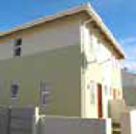

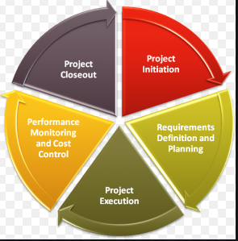
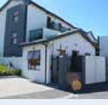
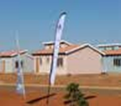


Our Value Proposition
SOCIAL HOUSING FINANCE – SUBSIDISED RENTAL ACCOMODATION
We provide long-term finance to Social Housing Institutions to develop affordable rental accommodation for HH earning R1 500 to R15 000.
STRATEGIC PARTNERSHIPS AND INVESTMENTS
We work closely with private investors, developers and housing development agencies and funds to leverage private sector and development funders to finance and create affordable housing that caters to the market that we serve..
PROGRAMME & FUND MANAGEMENT
Programme management and project implementation services are offered, under this programme, to provincial and local authorities to support the development of project and programme management capacity and enhance service delivery in the human settlement sector.
PRIVATELY - OWNED RENTAL HOUSING AND STUDENT ACCOMODATION FINANCE
We provide long-term finance to develop or refurbish affordable privately-owned rental (un-subsidised) accommodation.
INCREMENTAL HOUSING FINANCE
We provide funding to non-banking intermediaries who on-lend funding to home owners for incremental improvements (Rural & Urban)
SUBSIDY & AFFORDABLE HOUSING
FINANCE
We provide bridging and development finance to contractors and developers involved in the development of fully subsidised (BNG) and affordable housing (GAP & FLISP).
FINANCE LINKED INDIVIDUAL SUBSIDY PROGRAMME (FLISP)
We are the implementing agent for FLISP nationally. FLISP enables qualifying beneficiaries to reduce the initial home loan amount or augment the shortfall between the qualifying loan and the total house price.

Slide 6
HSDB Product Offering
Product and services
Commentary
HSDB will offer:
  Finance
  Fund management
  Guarantees
  Other services
Advisory and advocacy will be overarching service offerings that will be provided along with the instruments (debt, equity and both)
The offering will need to be determined by assessing the demand in the market from each primary customer and the ability for HSDB to meet that demand and remain sustainable
Guarantees require input from financial institutions, however a feasibility assessment would need to be conducted to assess viability
PRODUCTS AND SERVICES
Finance
Guarantees
Debt, equity and quasi-equity tailor-made products
Mortgage default insurance (MDI)
Guarantees
Other
Fund Management
Other Services
Coordination
Promotion
Advocacy
Provide technical assistance service
Management of 3rd party funds
New to HSDB

Slide 7
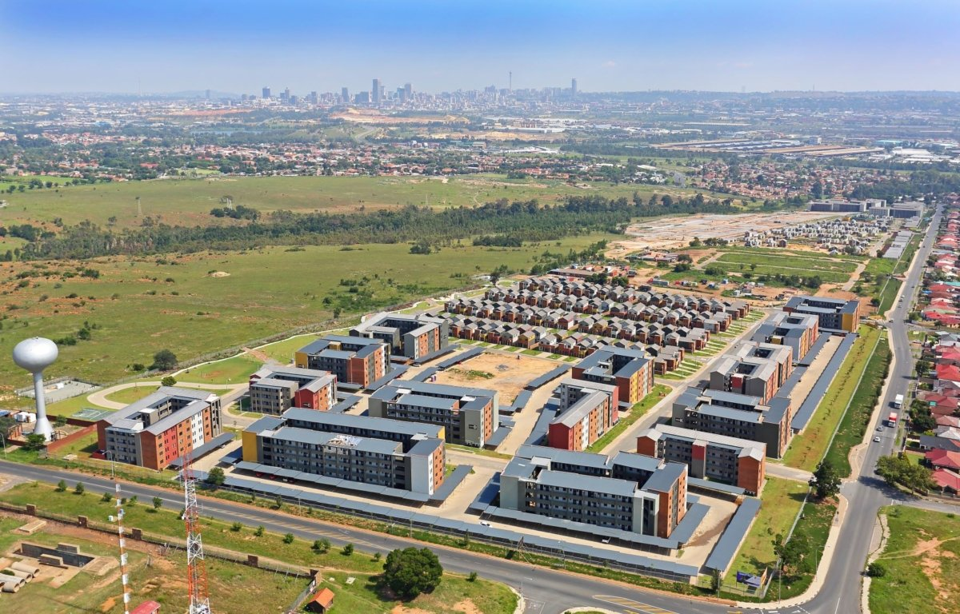

Maximize Development Impact
Facilitate the increased and sustained private sector investments and participation in the
under-served segment of the housing market
Additionality
Contribution that is beyond what is
available or that is otherwise absent
from the market
HSDB Aims
Transform the Human Settlements Sector
Facilitate market participation that enables the prioritisation of inclusivity, taking into account Size, PDIs, Women and the Youth, in the development of sustainable development of integrated human settlements
Achieve Sustainability
Delicate balancing of the twin challenges of HSDB as a DFI, namely, the achievement of greater developmental impact whilst ensuring that it is done in a sustainable manner
7

Slide 8
APPLICATION PROCESS AND CRITERIA
FUNDING CRITERIA
The Following Criteria are generic and will differ per product applied for
High Level Proposal
Project/Development viability (Feasibility Model)
CIPC Registration
Independently Reviewed and/or Audited AFS & latest Management Account
Market Study
BBBEE Certification/sworn affidavit
CV demonstrating experience of key personnel
Process
Origination
Pre-Assessment
Full
Appraisal
Sanctioning
Disburse funds
Prospective client/BDM submits funding application with all relevant documents as per checklist
Client manager assigned to assist client and asses application,
High level assessment of proposal (Viability Test)
Due diligence (Business/Credit and Legal)
Check all relevant documents (as per checklist)
Alignment of proposal with credit policy
Negotiate initial terms of contract
Proposal review by Board Credit & Investment Committee).
Approved (Grant Letter, finalise term sheet)
Draft loan agreement
DECLINE-notify applicant.
Finalise loan agreement contract
Client to meet PC’s
Disburse
Activities
Time-frame
Ongoing
5
Days
10
Days
27
Days
10 Days (LA)
3 months (PC’s)
Entire process is dependant on co-operation between NHFC and applicant
Provision of insufficient information, applicant inexperience and project complexity/magnitude can affect the turn around times
Disbursement of funds can take 6 to 12 months.
8

Slide 9

NHFC B-BBEE Initiatives
The NHFC Strategic Plan & APP outlines a strategy to empower black entrepreneurs and women, under one of its programmes, which is Programme 4: Sector Transformation.
The core function of this programme is to:
  To expand participation of previously disadvantaged individuals (particularly women and youth) and support the establishment of start ups
  Disbursements to PDIs
NHFC has committed and allocated 30% of all disbursements Women and Youth specifically.
NHFC has committed and allocated 35% of all disbursements to BBBEE entities.

Slide 10

NHFC B-BBEE Initiatives
The following APP extract demonstrates NHFC allocation to B-BBEE entrepreneurs and Women entrepreneurs for a 3 year period (APP):
  In the past financial year (2019/20), the NHFC and its partners, have managed to disburse a Total of R 566 Million to B-BBEE entrepreneurs including women and youth entrepreneurs. These disbursements were under the following programmes:
INCREMENTAL HOUSING
Wholesale funding provided to BBBEE retail intermediaries who on-lend to households or homeowners for incremental housing related purposes.
RENTAL HOUSING
Long term financing provided to BBBEE entrepreneurs who have purchased properties within the inner cities , which have been refurbished and provided as rental stock
R566 Mill
SOCIAL HOUSING
Social Housing Institutions which are led and managed by black individuals
SUBSIDY HOUSING
Bridging Finance provided to BBBEE entrepreneurs who have been awarded government housing tenders .

Slide 11
NHFC B-BBEE Initiatives
  What the NHFC has been doing for Black entrepreneurs and opportunities created
  Participated in an empowerment fund in partnership with the Gauteng Partnership fund (GPF), where long term debt was availed to 20 B-BBEE entrepreneurs, of which 5 were women owned, and received R84 Million in disbursements.
  Supporting Black led Social Housing institutions by restructuring facilities where boycotts and hijackings destabilised financial sustainability of these SHI’s
  Provided Covid-19 payment relief to a women lead Social Housing institution in an effort to assist in navigating current challenges.
  4 X Development Funding Loans were approved to women owned entities in the last 12 months.
  2 Facilities approved in 2019/20 Financial year to 2 Female owned start-up retail intermediaries for a combined R6,5million.
  NHFC enabled a partnership specifically aimed to empower emerging women property development company, a joint venture between a well-established developer and an emerging women owned developer which successfully completed 83 service stands
  Through the Contractor Finance Development Programme (CFDP), disbursed R36 million. (Discontinued but will be resuscitated under HSDB).
Source:

Slide 12
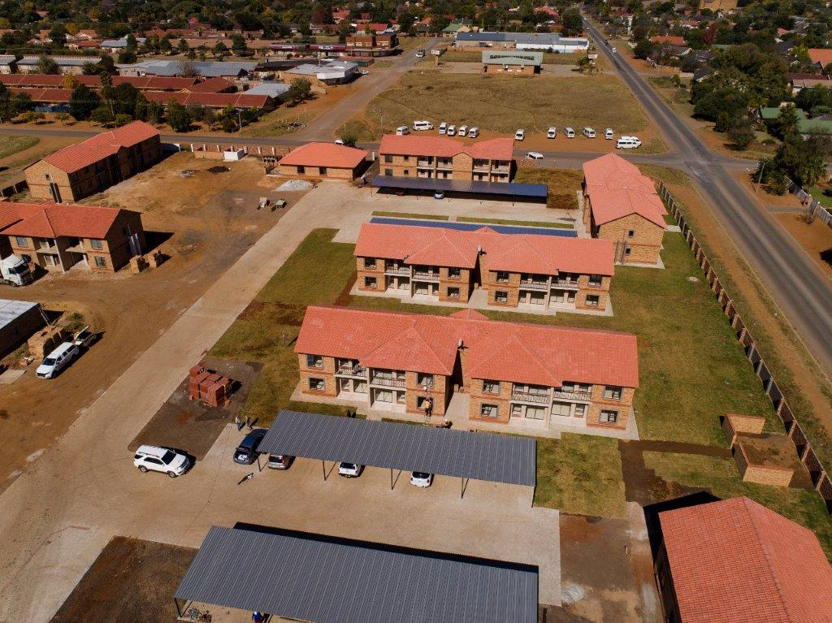
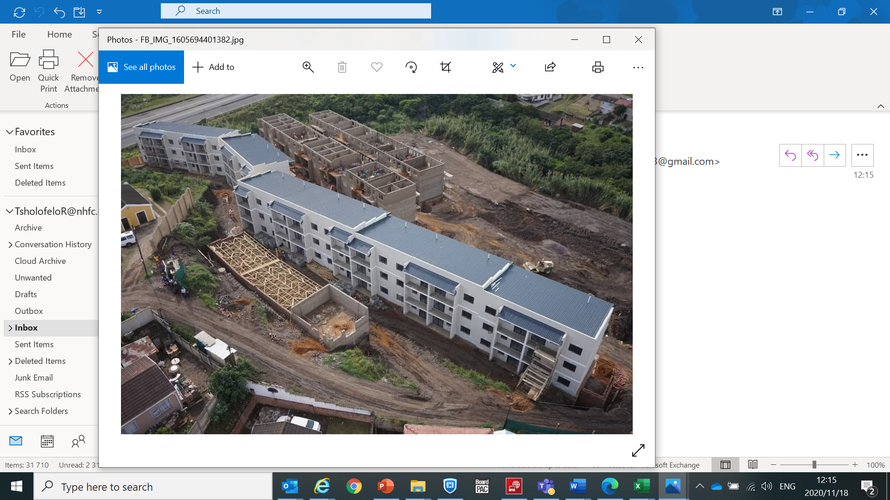
NHFC B-BBEE Case Study
ALLEY ROADS – 100% BLACK OWNED
Initial debt funding provided in 2012
Since then, NHFC has funded over 6 rental and sectional title developments
From the initial 119 units, this has yielded close to 900 units
ROODEPORT RENTAL DEVELOPMENT
Number of Units: 119 units
Product: Rental Product
Approval Date: 2012
Status: Completed
DURBAN SECTIONAL TITLE DEVELOPMENT
Number of Units: 94 units
Product: Sectional Title
Approval Date: 2017
Status: Completed
DAWN PARK RENTAL DEVELOPMENT
Number of Units: 20 units
Product: Rental Product
Approval Date: 2012
Status: Completed
KLERKSDORP RENTAL DEVELOPMENT
Number of Units: 101 units
Product: Rental Product
Approval Date: 2017
Status: Completed
DELMAS PHASE 1 & 2 RENTAL DEVELOPMENT
Number of Units: 216 units
Product: Rental Product
Approval Date: 2015 and 2017
Status: Completed
CHIAWELO RENTAL DEVELOPMENT
Number of Units: 132 units
Product: Rental Product
Approval Date: 2017
Status: In Construction
Source:

Slide 13

JHB OFFICE | CAPE TOWN OFFICE | DURBAN OFFICE | PORT ELIZABETH OFFICE
The Isle of Houghton Old Trafford 3, 11 Boundary Road, 2193 P.O. Box 31376 Braamfontein 2017 Phone: + 27 644 9800 Fax: + 27 11 484 6406 Website: www.nhfc.co.za | 7th Floor, Regus Business Centre Mandela Rhodes Place Corner Wale and Burg Street Cape Town 7446 Phone: 021 410 8957 | Flexible Workspace Centre 102 Stephen Dlamini Road Musgrave 4001 Phone: 031 313 3356 | PORT ELIZABETH OFFICE 3rd Floor, Fairview House Fairview Office Park 66 Ring Road, Greenacres Port Elizabeth 6057 Phone: 041 399 9460

