Slide 1
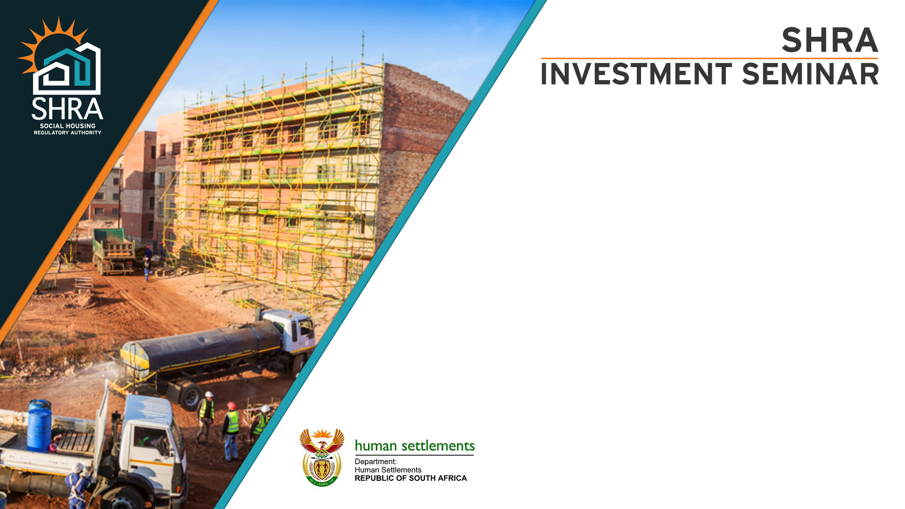
NEF Property Webinar
Presented by Emily Ngcobo, Portfolio Manager
19 November 2020

Slide 2

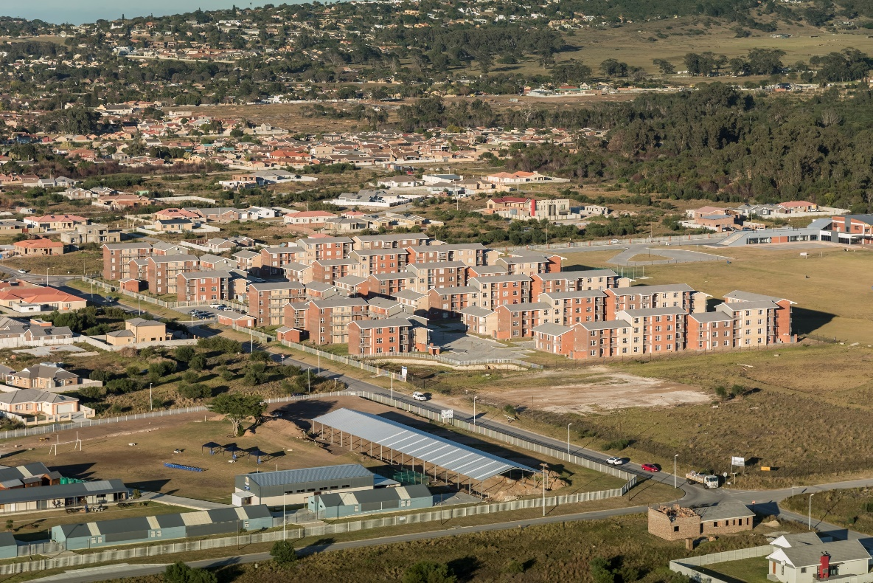
Agenda
NEF Property Webinar
SHRA mandate
Social housing
Economic climate
Infrastructure investment
SHRA project pipeline (not yet accredited)
SHRA initiatives: Response to expression of interest
SHRA initiatives: SIDDSA pitch – 19 projects
Projects with debt requirement

Slide 3
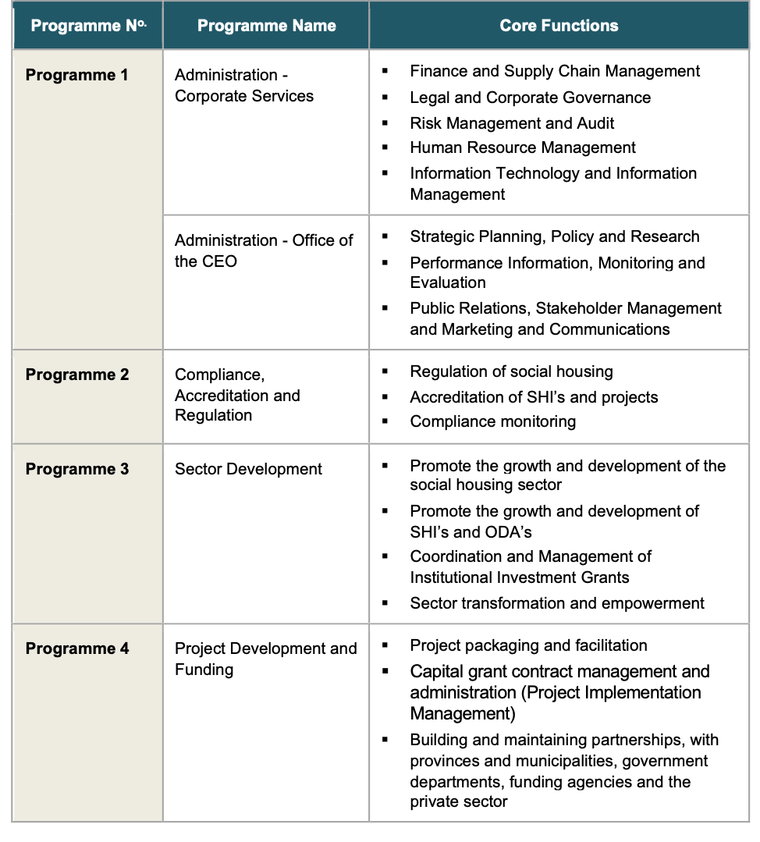
SHRA MANDATE
NEF Property Webinar
INVEST
We invest in social housing projects and accredit social housing institutions (SHIs) in order to foster the development of sustainable integrated communities.
ENABLE
We offer several types of grants to accredited SHIs to allow them to manage social housing projects and to develop projects.
REGULATE
We regulate SHIs who develop and manage social housing projects to ensure high quality rental housing is available and affordable to the low to middle income group.
SHRA PROGRAMMES
3

Slide 4
NEF Property Webinar
Transformation requirements
A transformed social housing value chain
% of (CCG) allocation awarded to black majority owned / controlled enterprises
PDF (CCG)
% of CCG allocation awarded to the collective of enterprises designated as majority owned or controlled by women, youth, persons with disabilities and military veterans
% of IIG recipients that are majority black owned or controlled
  Targeted training interventions (SAIBPP, SAWIC etc)
  Incubation Programme (2020/21)
  Formal Inclusion for Social Housing in the Property Sector Code (2020/21)
SD&T (IIG)
% of projects in the pipeline that are from capital grant applicants that are black majority owned or controlled
CAR
ACCREDITATION

Slide 5
NEF Property Webinar
Typical funding of social housing
Current CCG of R271 678 p.u funds from under 45% in the case of mid to high-rise development (R600k) to at best 67.2% on the lowest end.
DEVELOPMENT COSTS
Description | Cost per unit
New High-rise (CAHF Dec 2019 – ex VAT R84 117) | R593 521
New walk-up (CAHF Dec 2019 ex Vat R67 846) | R479 363
New Mid to High-rise (SHRA Cost Drivers as at March 2019 – ex VAT R62 748) | R548 805
Greenfield walk-up (SHRA Cost Drivers as at March 2019 ex Vat R48 236 ) | R487 008
Original 2017 Development Cost parameter of R358 306 Escalated by BER BCI to March 2020 | R425 783
Weighted Average Development Cost Per Unit (2018/19-2019/20) SHIP 9 & 10 | R404 293
Simple Average Development Cost Per Unit from 26 active projects – SHIP 9 & 10 | R404 170

Slide 6
Agenda
NEF Property Webinar
SHRA mandate
Social housing
Economic climate
Infrastructure investment
SHRA project pipeline (not yet accredited)
SHRA initiatives: Response to expression of interest
SHRA initiatives: SIDDSA pitch – 19 projects
Projects with debt requirement

Slide 7
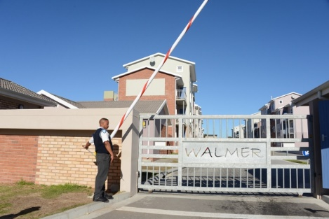
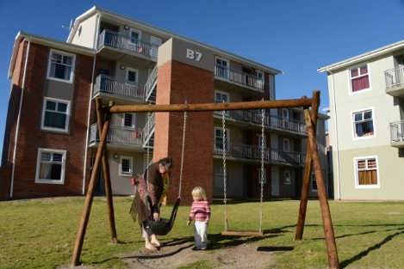
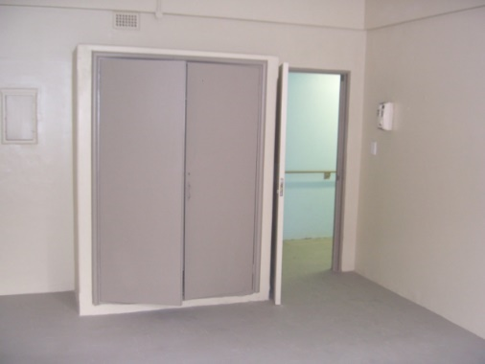
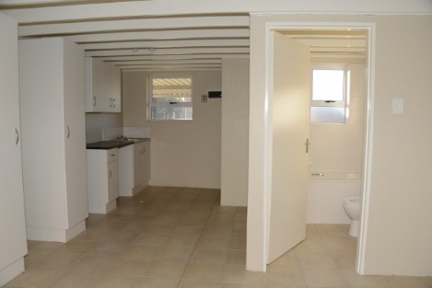
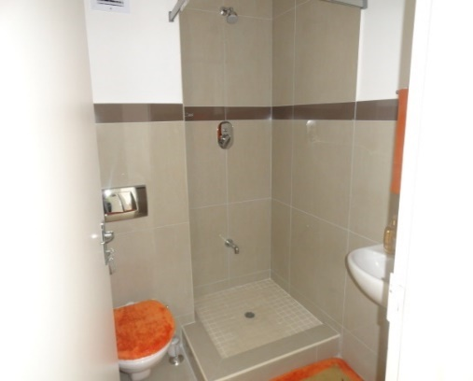
What is social housing?
NEF Property Webinar
Rental accommodation for people earning between R1500 and R15 000 per month and therefore do not qualify for a BNG house or a housing bond.
Social housing is partly subsidised by the government and therefore this high-quality accommodation is kept at affordable rental rates.

Slide 8
Agenda
NEF Property Webinar
SHRA mandate
Social housing
Economic climate
Infrastructure investment
SHRA project pipeline (not yet accredited)
SHRA initiatives: Response to expression of interest
SHRA initiatives: SIDDSA pitch – 19 projects
Projects with debt requirement

Slide 9
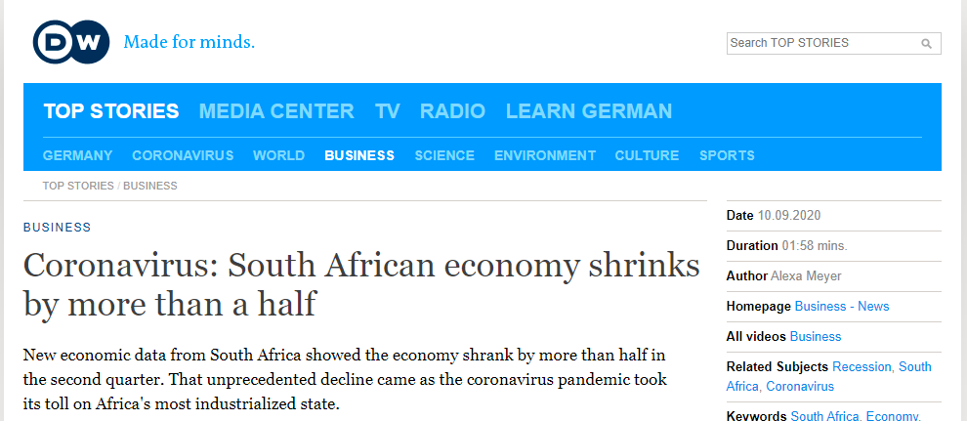
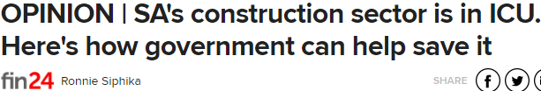
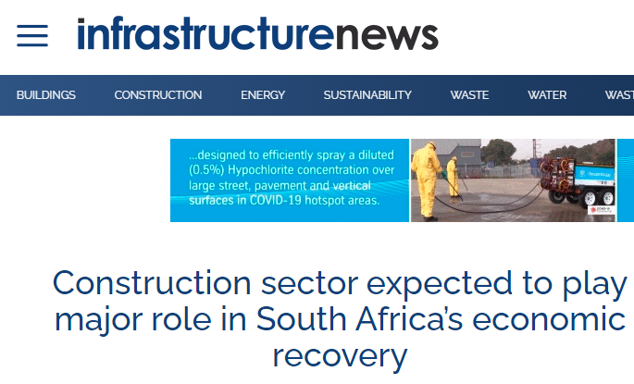
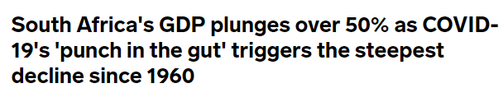
Declining economic growth
NEF Property Webinar
51% shrinkage in GDP in the past quarter when compared with the same period in 2019.
South African GDP will shrink by between 7% and 16% in 2020 as a direct result of COVID-19.
South African Debt to GDP was already 62,6% in 2019 before GDP shrank, and is expected to reach 81,8%
by the end of 2020.
South African unemployment rate rose to 30,1% in the first three months of the year before the COVID-19
lockdown and the unemployment rate is projected to reach 37% in 2021 according to some economists.
Businesses closing their doors and many families have experienced lay offs of either one or both bread winners.
The economy is a system and damage this severe can never take place and leave an already inefficient public sector untouched.
Construction industry has insufficient work to support the capacity of the industry;
Order book of construction enterprises remains too lean for them to sustain their overheads over a prolonged period of time.

Slide 10
Agenda
NEF Property Webinar
SHRA mandate
Social housing
Economic climate
Infrastructure investment
SHRA project pipeline (not yet accredited)
SHRA initiatives: Response to expression of interest
SHRA initiatives: SIDDSA pitch – 19 projects
Projects with debt requirement

Slide 11
Infrastructure development office* SIDS
NEF Property Webinar
Seeks to create a platform through which private investment can be channeled to deserving infrastructure investment projects. The proposal is one of blended financing where the risks of the different investing partners can be spread, and where the IIP can facilitate an attractive rate of borrowing for these projects.
Within the Human Settlements space, the basic tenure and shelter provision programmes would not be able to attract non-state investment because of their non revenue generating nature. Government’s affordable rental housing programme (Social Housing) is however viewed positively due to its revenue generating nature.
Intends to invest in the construction of 37,000 rental apartments as part of the project pipeline supported through the Infrastructure Investment Programme over the next 10 years. Inclusion Social Housing in the national IIP list of supported infrastructure projects brings an opportunity to link financing to projects quicker, and potentially at a more attractive financing cost.
Investment in infrastructure is key to economic recovery especially in the shadow of Covid-19
*Announced by the Minister of Finance in 2019 and again emphasized by the President in the Nation Address (SONA) on 13 February 2020

Slide 12
Agenda
NEF Property Webinar
SHRA mandate
Social housing
Economic climate
Infrastructure investment
SHRA project pipeline (not yet accredited)
SHRA initiatives: Response to expression of interest
SHRA initiatives: SIDDSA pitch – 19 projects
Projects with debt requirement

Slide 13
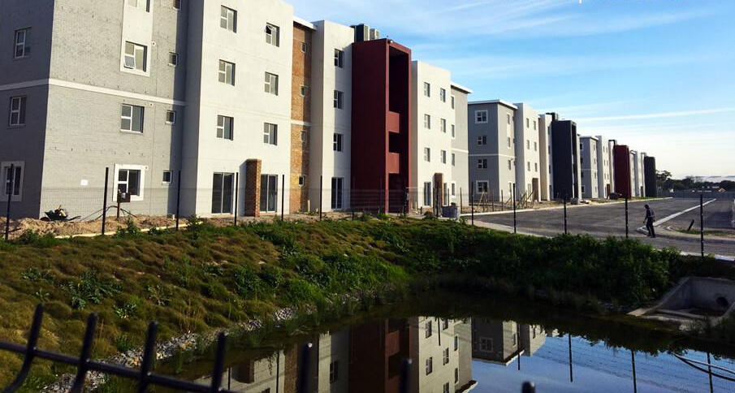
Project pipeline (not yet accredited)
NEF Property Webinar
As of 03 August 2020, Quarter 2:
We have registered 70 projects in our pipeline yielding 26395 units. Split between 26 project applications by SHI and 44 projects by ODA’s.
Of the 70 Projects in the pipeline, 11 Projects are ready for external assessments and discussions at Project Accreditation Committee.

Slide 14
Project pipeline (not yet accredited)
NEF Property Webinar
The Gauteng province has the largest number of units in our pipeline followed by KwaZulu Natal. With Western Cape with the least projects registered on to the pipeline.

Slide 15
Project pipeline (not yet accredited) - Municipalities
NEF Property Webinar
The project distribution amongst the metros and municipalities with Gautng leading, as it stands, there are currently no projects registered in our pipeline for the Limpopo and the Northern cape provinces.

Slide 16
Agenda
NEF Property Webinar
SHRA mandate
Social housing
Economic climate
Infrastructure investment
SHRA project pipeline (not yet accredited)
SHRA initiatives: Response to expression of interest
SHRA initiatives: SIDDSA pitch – 19 projects
Projects with debt requirement

Slide 17
Responses to Expression of Interest
NEF Property Webinar
EXPRESSION OF INTEREST RESPONSES
Province | No. | %
GP | 25 | 39%
KZN | 11 | 17%
MP | 10 | 16%
WC | 1 | 2%
EC | 7 | 11%
LIMP | 2 | 3%
NW | 5 | 8%
FS | 3 | 5%
NC | 0 | 0%
 | 64
In Quarter 1, the SHRA advertised an expression of interest;
64 responses to the expression of interest have been received and currently being processed.

Slide 18
Agenda
NEF Property Webinar
SHRA mandate
Social housing
Economic climate
Infrastructure investment
SHRA project pipeline (not yet accredited)
SHRA initiatives: Response to expression of interest
SHRA initiatives: SIDDSA pitch – 19 projects
Projects with debt requirement

Slide 19
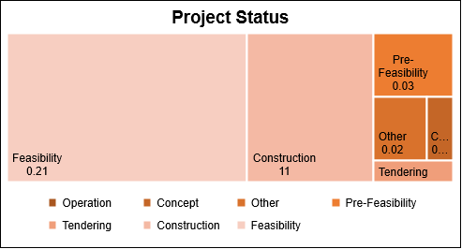
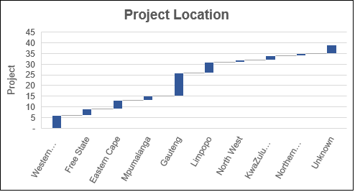
SIDDSA presentation: Sector overview in graphs
NEF Property Webinar
12 Projects submitted are at Planning Phase
9 Projects submitted are at Feasibility Phase
Projected investment value inclusive of equity and debt funding R3 869 079 577
Projected employment opportunities 32131

Slide 20
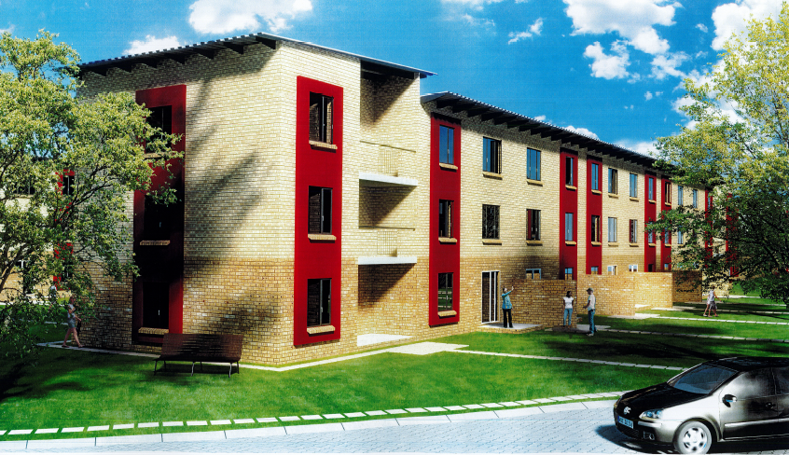
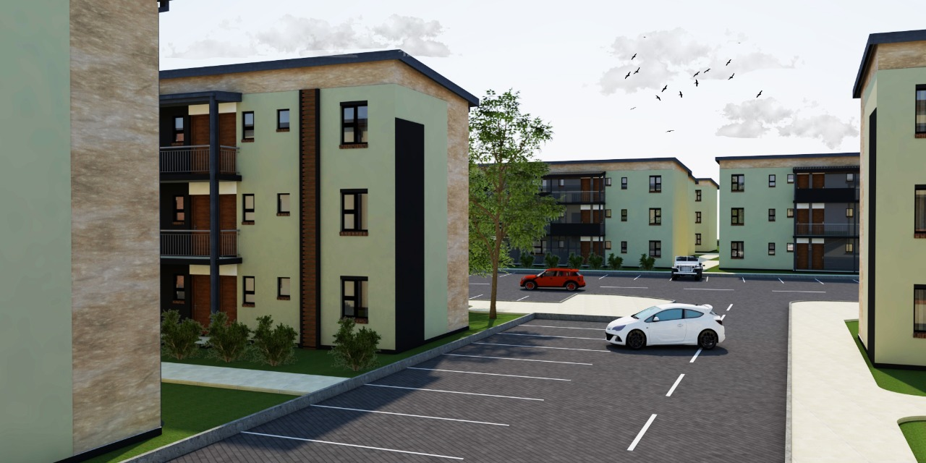
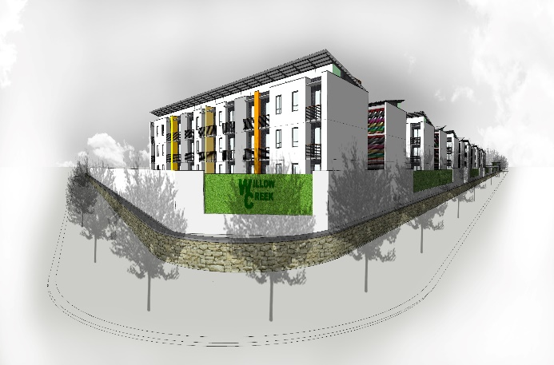
SIDDSA presentation: Investment opportunity
NEF Property Webinar
BANKABLE PROJECTS
(SHRA accredited projects)
EQUITY | DEBT
R93 537 386 | R406 633 539
PROJECT IN FEASIBILITY PHASE
EQUITY | DEBT
R360 578 173 | R424 625 270

Slide 21
Agenda
NEF Property Webinar
SHRA mandate
Social housing
Economic climate
Infrastructure investment
SHRA project pipeline (not yet accredited)
SHRA initiatives: Response to expression of interest
SHRA initiatives: SIDDSA pitch – 19 projects
Projects with debt requirement

Slide 22
Project Development & Funding: SHIP Active Projects
Debt Requirements
NEF Property Webinar
SHIP | PROVINCE | DELIVERY AGENT | PROJECT | # UNITS | RCG\CCG VALUE | DEBT\EQUITY VALUE | DEBT FUNDER
SHIP 5A | EC | Qhama | Steve Biko Munford | 220 | R27 635 300,00 |  | ECDC
 | EC | Hlalanathi | Ocean View | 603 | R75 745 845,00 |  | No debt funding
 | GAU | ISP (Instratin) | Devland Gardens | 870 | R113 829 725,00 | R33 880 000,00 | NEF
 | WC | USR | The Block | 512 | R52 255 840,00 |  | NHFC
 | FS | Free State Housing Association | Brandwag Ph 3 | 154 | R19 344 710,00 |  | NHFC
SHIP 6A | NW | Gabonewe Housing Estate | Gabonewe | 801 | R100 617 615,00 |  | Wesizwe Mine
SHIP 7A | EC | OHHA | Walmer Cosmo | 630 | R97 650 000,00 |  | NHFC
SHIP 7C | GAU | Golden West | Westornaria Borwa | 582 | R90 210 000,00 | R71 912 926,00 | NHFC
 | GAU | HCT | Townlands | 691 | R118 885 000,00 |  | N/a
SHIP 7D | GAU | Urbanscape | 301 Marshall | 42 | R6 510 000,00 |  | Investico Holding
 | GAU | HCT | Townlands | 509 | R78 895 000,00 |  | N/a
 | GAU | Nomda | Germiston | 262 | R31 155 000,00 | R23 425 023.00 | No debt funding
 | GAU | Arrow Creek | Mogale Junction | 1590 | R223 823 550,00 | R96 711 876,82 | HNFC

Slide 23
Project Development & Funding: SHIP Active Projects
Debt Requirements
NEF Property Webinar
SHIP | PROVINCE | DELIVERY AGENT | PROJECT | # UNITS | RCG\CCG VALUE | DEBT\EQUITY VALUE | DEBT FUNDER
SHIP 8B | FS | Kenso | Hill Side | 839 | R178 528 839,00 |  | No debt funding
 | GAU | Instratin | Carnival Gardens | 888 | R236 160 936,00 | R88 206 227,00 | SAHL
 | WC | DCI | Heideveld | 180 | R47 870 460,00 | R10 960 303 | SASFIN in process
 | WC | DCI | Goodwood | 1055 | R280 574 085,00 | R89 153 274 | NHFC
SHIP 8D | GAU | Toro | Garankuwa | 1592 | R423 387 624,00 | R185 615 430,00 | SAHL
 | WC | Povicom | Regent Villa | 104 | R27 658 488,00 | R11 847 017 | NHFC
SHIP 9A | GAU | YG Property Investment | Kempton Village | 312 | R82 680 000,00 | R24 519 577 (D) R14 870 427 (Eq) | NEF
 | GAU | THH | Mohlakeng | 1080 | R287 222 760,00 | R83 217 005,00 | RMB
SHIP 9C | GAU | EHC | Clayville | 452 | R121 972 258,00 | N/A | N/A
 | GAU | Lets Care | Sondela | 246 | R66 879 282,00 |  | NEDBANK
 | MPU | STHA | Hope City | 114 | R30 992 838,00 | N/A | NEDBANK
SHIP 9D | EC | Imizi | John Street | 385 | R133 236 542,00 | R36 155 689 | NHFC
SHIP 9E | WC | Communicare | Bothasig Gardens | 314 | R85 366 238,00 |  | Mergence
 | LIMP | PHA | Ga Rena (Annandale) | 494 | R134 302 298,00 | R71 389 673,00 | City of Polokwane

Slide 24
Project Development & Funding: SHIP Active Projects
Debt Requirements
NEF Property Webinar
SHIP | PROVINCE | DELIVERY AGENT | PROJECT | # UNITS | RCG\CCG VALUE | DEBT\EQUITY VALUE | DEBT FUNDER
 | GAU | Instratin | Little Manhattan | 708 | R193 579 236,00 |  | Nedbank
SHIP 9F | KZN | Instratin | Bridge City | 1130 | R307 209 710,00 | R125 000 000,00 | ABSA
 | GAU | Kertrade | Madison Loft | 100 | R27 186 700,00 |  | TUHF
SHIP 10A | KZN | Buhlebezwe Property | Hospital Street | 1056 | R297 091 552,00 | R97 185 365,00 | JJP Prop/ NIH
 | GAU | Castle Crest | Joes Place | 43 | R11 690 261,00 |  | N/A
 | GAU | Mangabane | Clayville | 85 | R23 108 695,00 |  | in process
SHIP 10B | GAU | GNI-Jeppe's Town* | Unity House | 95 | R25 827 365,00 | R6 899 207,20 | NEF
 | WC | Povicom | Regent Villa | 60 | R16 312 020,00 |  | in process
SHIP 10C | GAU | Lets Care | Sondela Village | 177 | R48 120 459,00 | R11 368 125,00 | NEDBANK
 | GAU | Isibani Anami | Phola Heights | 688 | R187 044 496,00 | R10 000 000,00 | in process
 | NC | SASIC | Hull Street | 372 | R101 134 524,00 | R620 000,00 | in process
 | GAU | Jidmac* | Fochville Ext 11 | 258 | R70 141 686,00 | R14 213 753,00 | NHFC - letter of intent
 | WC | Own Haven | Conradie Park | 432 | R117 446 544,00 | R48 846 235,00 | NHFC

Slide 25
Project Development & Funding: SHIP Active Projects
Debt Requirements
NEF Property Webinar
SHIP | PROVINCE | DELIVERY AGENT | PROJECT | # UNITS | RCG\CCG VALUE | DEBT\EQUITY VALUE | DEBT FUNDER
SHIP 10D | MPU | Mzansi Housing | Willow Creek | 360 | R99 546 120,00 | R33 798 189,00 | in process
 | WC | Pine Roads | SOCHO | 243 | R73 220 031,00 | R16 662 279,00 | in process
 | MPU | GMHA | Kwandokuhle | 492 | R133 758 564,00 | R44 588 673,79 | in process
SHIP 11A | GAU | Nthwese | 56 Main | 125 | R34 370 875,00 | R18 805 939,00 | in process
SHIP 11B still to be tabled | GAU | Nthwese | 88 Main | 170
 | WC | Instratin | Paarl Mountain | 362
 | GAU | EHC | Fire Station | 152 |  |  | N/A

Slide 26
Highlights and lowlights
Emerging issues requiring immediate attention
NEF Property Webinar
HIGHLIGHTS
LOWLIGHTS
EMERGING ISSUES
Sids…
The grant funding allocation over the MTEF period
Sustainability from rental revenue stream to repay debt/loan funding
A regulated sector with an Act and Regulations to manage post development Monitoring and Evaluation of the sector
Sids…
Regulatory requirement for a 20% equity by the ODAs (Private entities)
Rental escalation not exceeding CPI. Funders expect a market driven escalation
Heavily regulated structure. This is the reason government is so heavily invested in the sector
Sids…
Construction Mafia activity
Municipalities charging commercial rates and taxes to the sector
Serviced land parcels being set aside by the Municipalities for social housing development
Community uprising due to service delivery issues affecting social housing developments
Project delays due to COVID19 lockdown restrictions.

Slide 27
How to partner with the SHRA
NEF Property Webinar
I am an looking to get accredited
The SHRA accepts applications every quarter and SHIs will be notified of the outcome within 90 days of receipt of the application.
I want to accredit a project for funding
SHIs and ODAs who wish to apply for funding (CCG) must submit projects to the SHRA pipeline in order to go through the project accredittaion process.
How can you assist me to meet the SHRA's funding and compliance requirements?
The SHRA offers an institutional grant subsidy to support and develop SHIs, ODAs, cooperatives, provinces and municiplaities.
The application includes submission of the quick scan (QSA) which is the organisational due dlligence of the SHI or ODA.
Applications that meet the criteria will be recommended to the SHRA Council for consideration and will be given conditional or full accreditation status if the application is approved.
ODAs do not need to apply for accreditation but they must submit a QSA with each project that they submit for accreditation., while SHIs are only required to submit it once.
Projects that are not suitable for social housing will be pulled out of the project pipeline.
Projects that meet the minimum investment criteria will be recommended to the SHRA Council for consideration.
Approved projects will qualify for a CCG of R271 867 per unit (up to 70% of the total cost of the proejct.
The grant includes the following:
- Staff gear-up grant;
- Remedial action grant and
- General capacitation grant.
Applications for this grant go through the Sector Development and Transformation unit and are recommeded to the Executive Committee of the SHRA for consideration, should they meet the qualifying crieria.
- Pre-accreditation grant;
Allprojects submitted must have provincial support and located within a restructuring zone.
The project accredittaion process entails submition of the QSB (assessment of the project) and QSC (projet financial viability).
SHIs can fund the balnce through a combination of debt funding and own equity while ODAs must contribute a minimum of 20% own equity and the balance can be funded through debt funding.
Project that need assistance with meeting the SHRA's requirements will be recommended to the Sector Development and Transformation unit for support.
Expression of Interests
Call for proposals
Information sessions
Training
Projects that have been completed and tenanted will be handed to the Compliance unit of the SHRA and SHIs and ODAs must submit quarterly reports to the SHRA. This ensures that the projects comply and are managed in accordance with the Social Housing Act and Social Housing Regulations.
Incubation programme
MOUs with funders
Email us on info@shra.org.za for more information or to set-up engagements through stakeholder management team

Slide 28
THANK YOU
NEF Property Webinar

